Slide 1
Chapter 16
Macroevolution---Looking at biodiversity over a long period of time—understanding how really different species arose from a common ancestor. (also known as speciation)
Darwin and Wallace were more concerned with macroevolution, though concepts of microevolution apply. (Like natural selection)

Slide 2
How long is a long period of time…
The history of life on earth dates back…3.5 billion years.

Slide 3
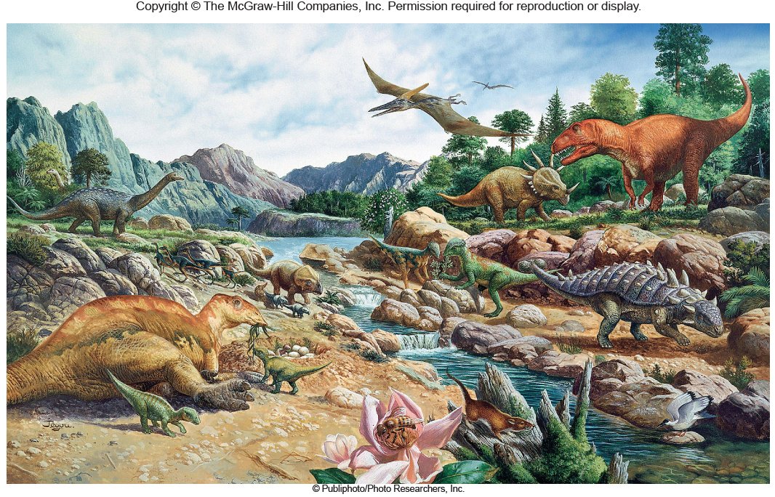
Figure 16.1 Dinosaurs---how long ago was this?

Slide 4
Table 16.1 The Geological Timescale: Major Divisions of Geological Time and Some of the Major Evolutionary Events That Occurred

Slide 5
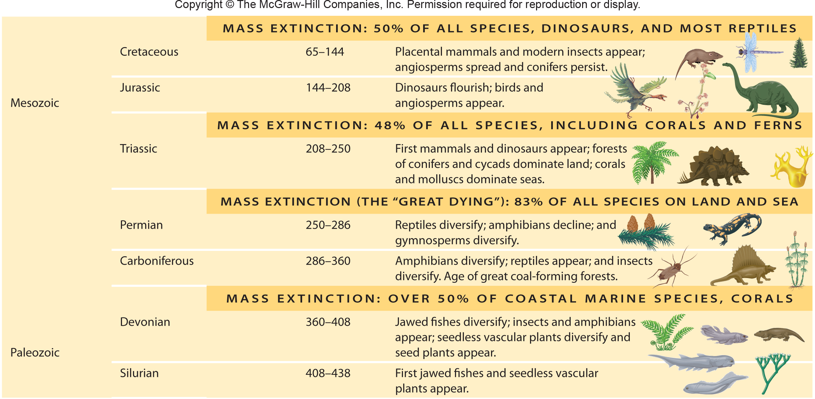
Table 16.1 continued

Slide 6
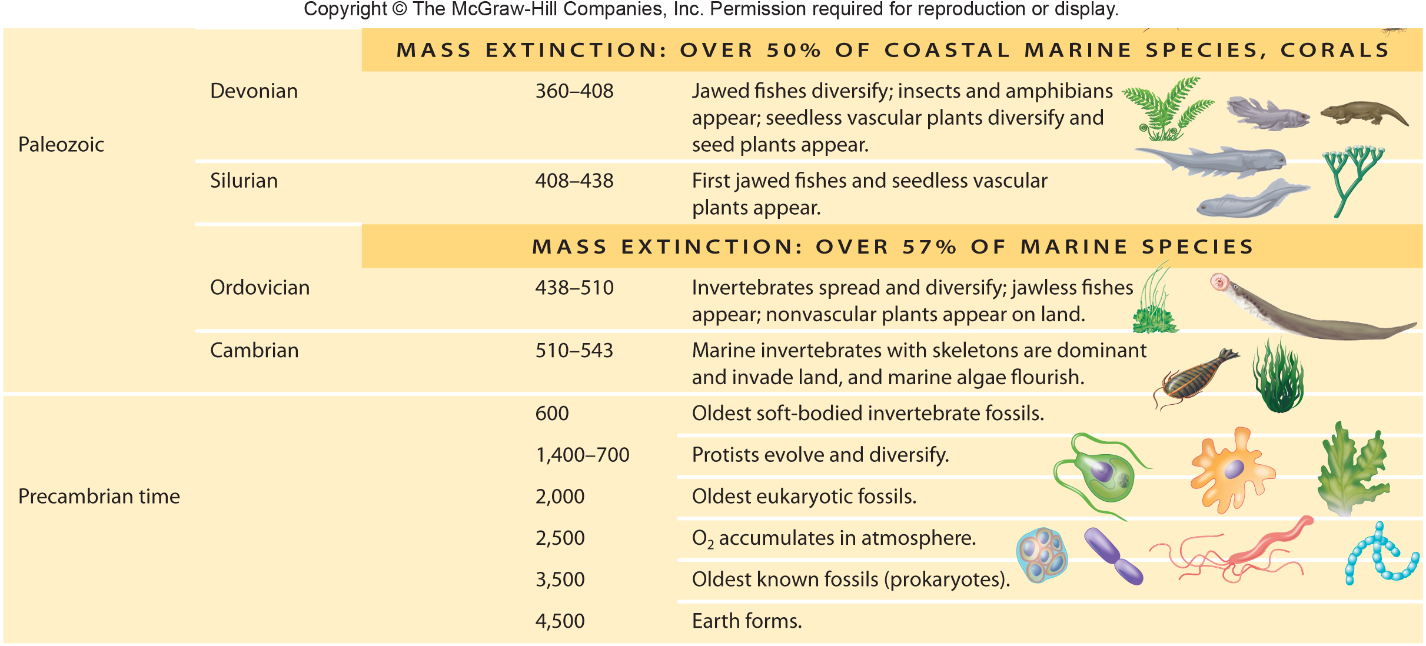
Table 16.1 continued

Slide 7
Darwin and Wallace proposed that the variation we see in life on earth is the result of repeated natural selection events---
At some point in time, previously similar creatures become so different they can’t successfully breed. They are considered different species.

Slide 8
16.1 Speciation and Macroevolution
How do we define a species?

Slide 9
Biological species concept
Members of a species
Interbreed
Have a shared gene pool
Produce fertile offspring
Not based on appearance
Flycatchers look similar but are different species
Humans can look very different but are the same species

Slide 10
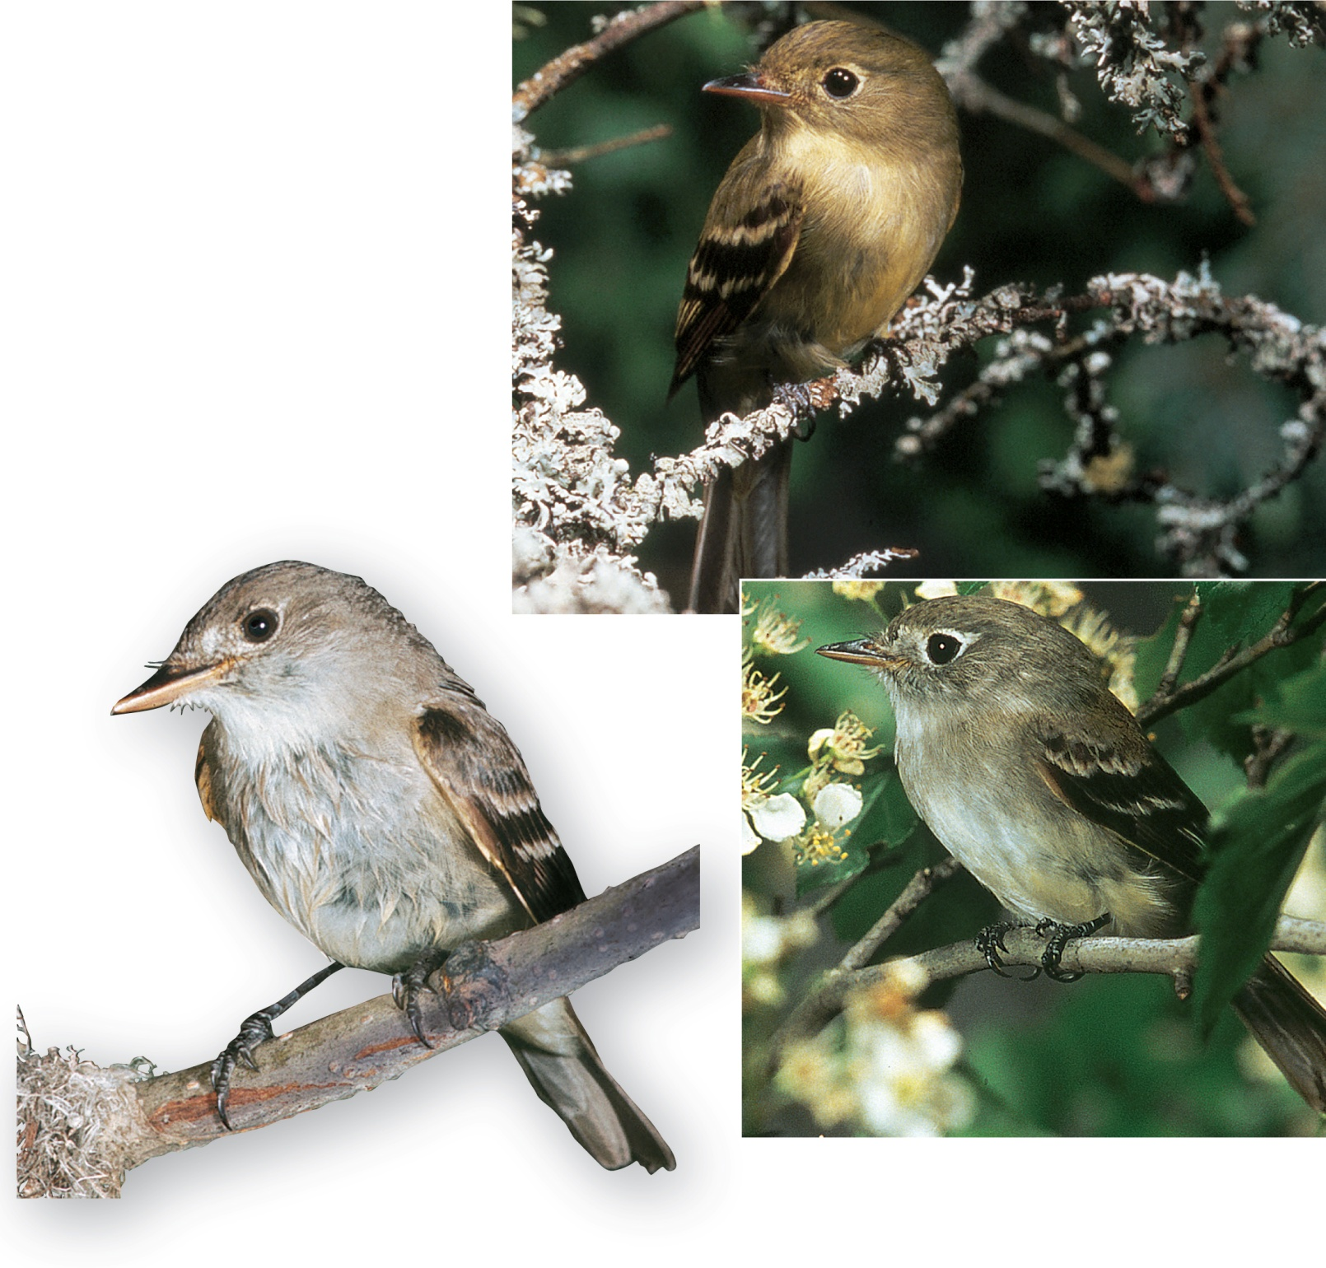
Figure 16.2 Three species of flycatchers
Flycatchers may look similar and yet do not interbreed in nature – are different species.
Copyright © The McGraw-Hill Companies, Inc. Permission required for reproduction or display.
Acadian flycatcher,
Empidonax virescens
Traill’s flycatcher,
Empidonax trailli
Least flycatcher,
Empidonax minimus
(Acadian): © Karl Maslowski/Visuals Unlimited; (Traill's): © Ralph Reinhold/Animals Animals; (least): © Stanley Maslowski/Visuals Unlimited

Slide 11
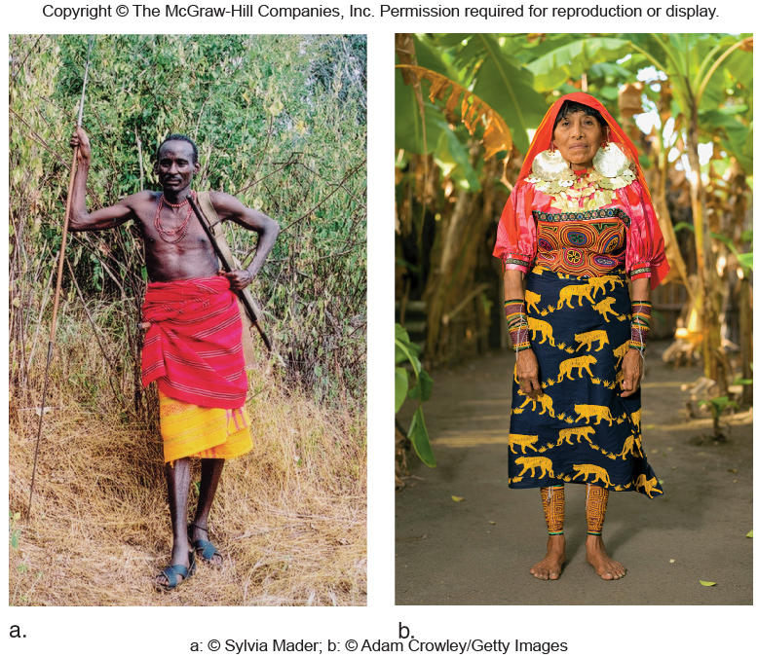
Figure 16.3 Human populations
Humans can look very different and yet can interbreed – are the same species.

Slide 12
The biological species concept only applies to living sexually reproducing organisms
It does not apply to bacteria that reproduce asexually or fossils (DNA evidence helps us recognize different species)
Other definitions of species
Category of classification below rank of genus
Species in the same genus share a recent common ancestor

