Slide 1
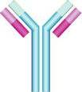
Immunology Biol 465 Minot State University Spring 2020
MWF 9-9:50 am
Lab Tuesdays 9am-noon

Slide 2
Lecture 17 March 4th , 2020

Slide 3
Where were we? Ig constant regions
We’ve focused our attention on one end of the Ig molecules—The variable region.
What about the constant regions…how do they become linked?

Slide 4
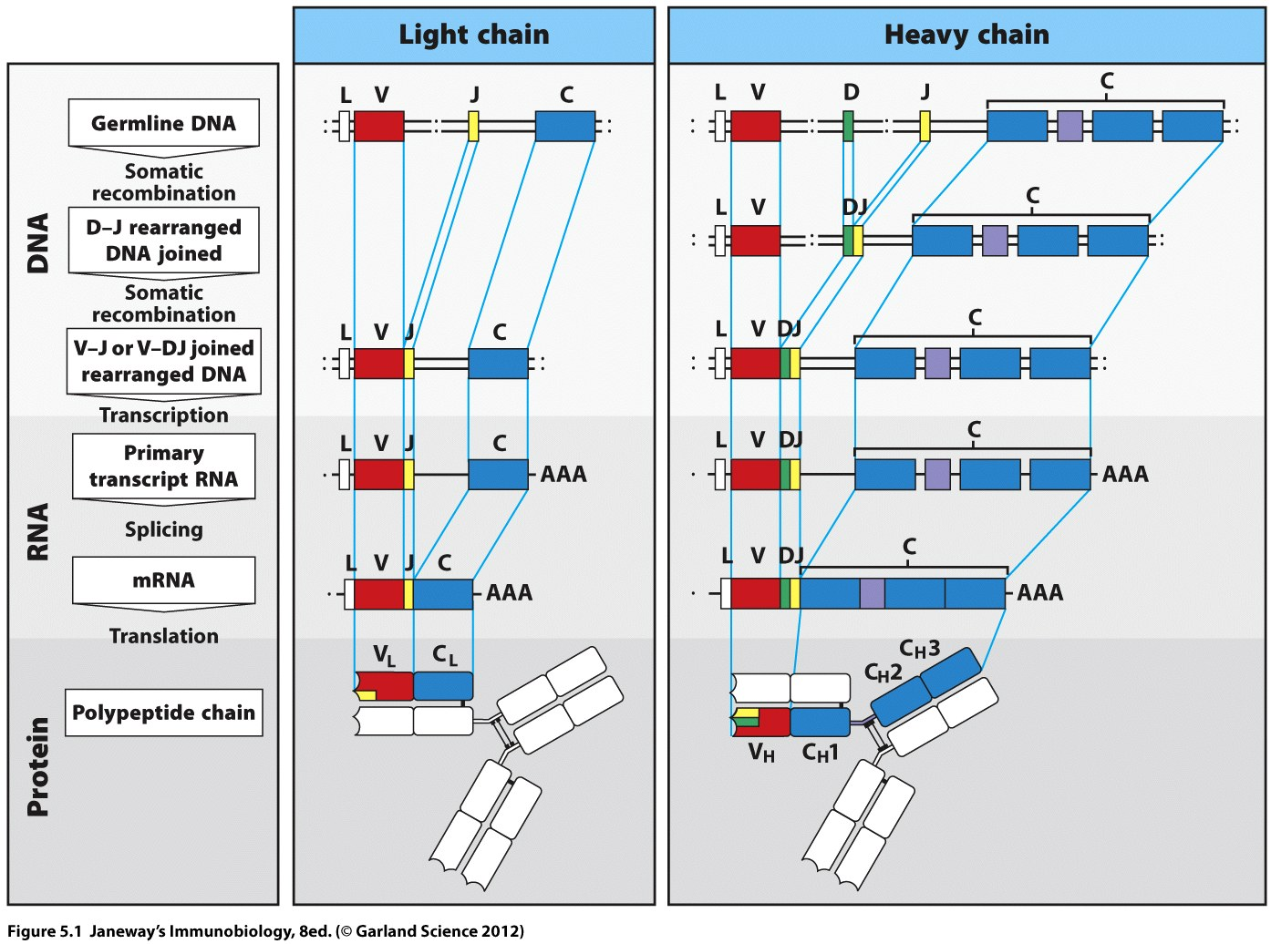

Slide 5
First—light chains
The light chains C-region is joined to the joined V-region gene segments AFTER transcription. It’s not joined by somatic recombination. Each C region is complete in itself and encodes a non-changing constant region.

Slide 7
H-chains
H-chain constant regions are also, joined after transcription (after recombination of V-region), but are a bit more complex.
For example, the c-regions resemble most genes in eukaryotes, having introns and exons. (The multiple boxes are the exons, not gene segments)

Slide 9
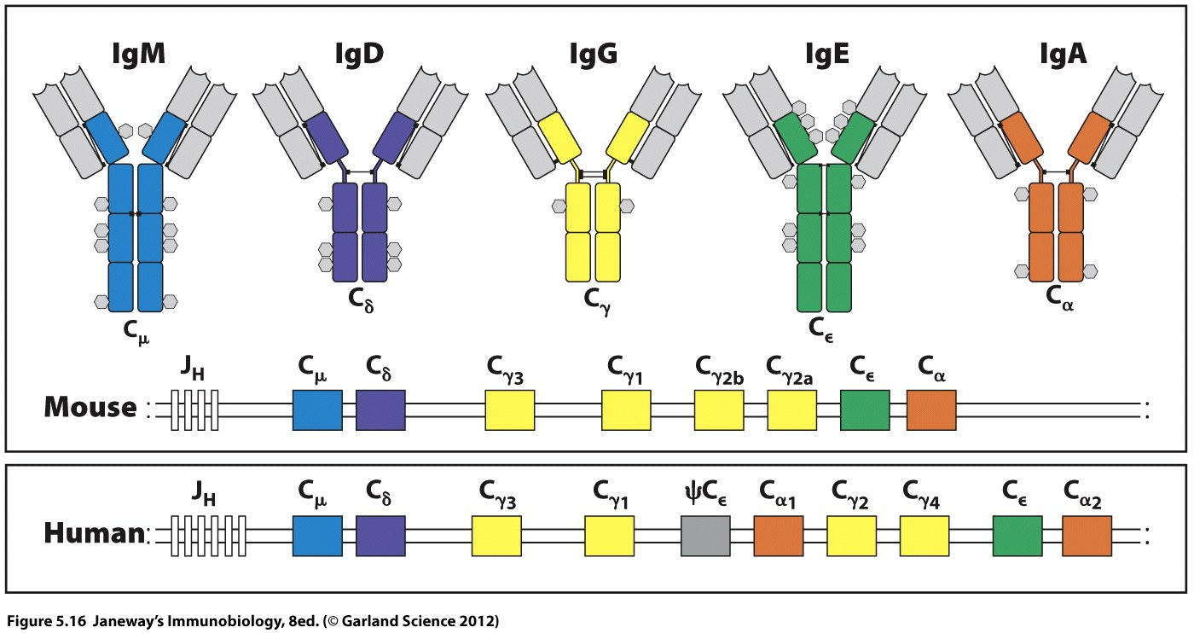
The 5 isotypes of antibody differ in the sequence in the Heavy chain constant region.

Slide 10
Note that they are in a specific linear order. Cμ and Cδ are closest to the V-region.
IgM and IgD are the Ig that have H-chain Cμ or the Cδ as their constant region. They are the first types of Ig produced in an adaptive immune response.
They both serve as the BCR in naïve B-cells

Slide 11
Note the order of C-region coding sequences
Mature, naïve B-cells express both IgM an IgD (on the same cell)
Both constant regions are transcribed into one long mRNA, containing coding sequence for the 2 isotypes.
BUT an antibody cannot have 2 constant regions.

Slide 12
AFTER transcription, but before the mRNA is completely spliced together, one of the 2 C regions is spliced to the rearranged V-region. The mechanism is called alternate/alternative splicing.
This is NOT isotype switching and is not unique to Ig genes or to lymphocytes.

Slide 13
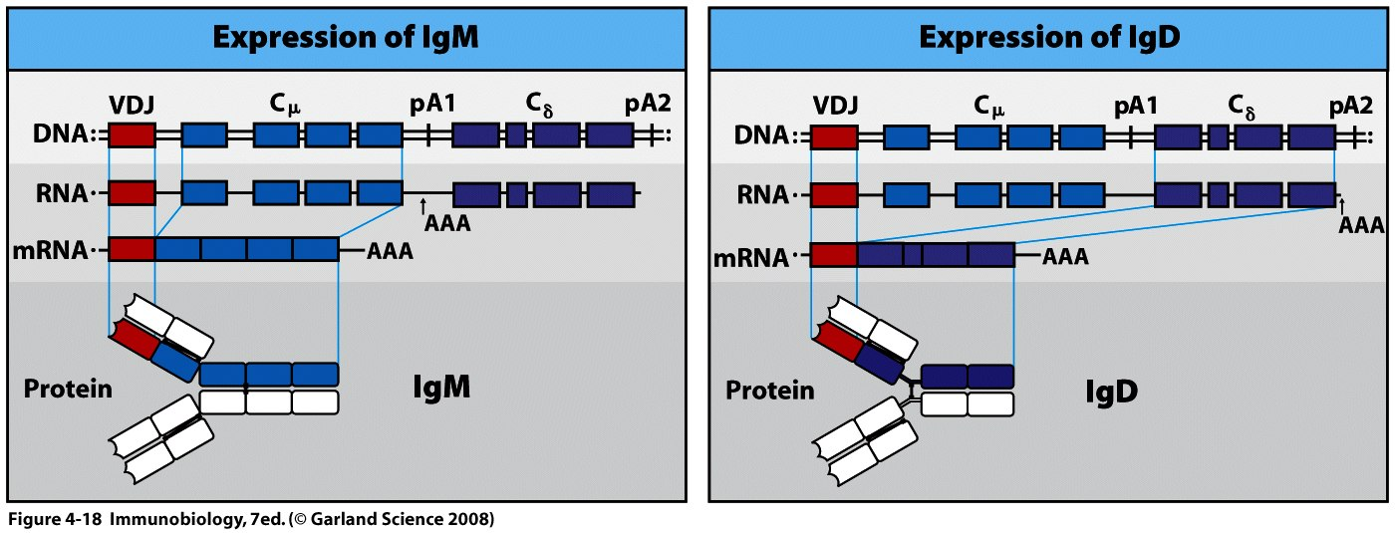

Slide 14
We even see 2 versions of IgM due to alternative splicing.
Recall that IgM is also the BCR which means it is anchored to the cell membrane.
But later on IgM is a secreted atibody

Slide 15
If we believe that amino acid sequence determines function/behavior of the protein, we’d have to assume the anchored and secreted forms of Ig must differ in some way.

Slide 16
The main difference is the presence or absence of the anchor! The C-terminus of each type of protein differs due to selection of different exons to encode it.

Slide 17
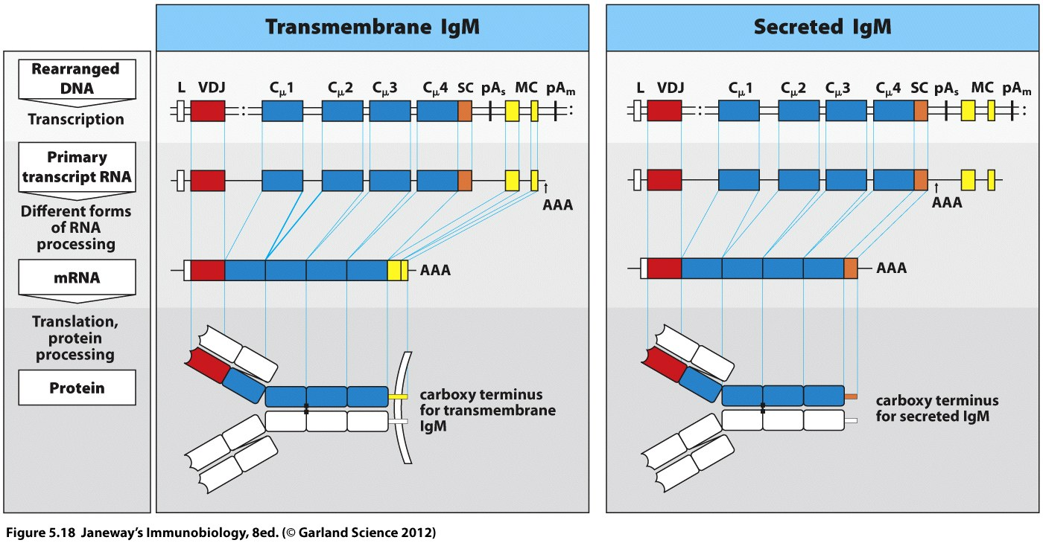

Slide 18
Neither of these alternative splicing processes is isotype switching. Both occur before a B-cell binds its cognate antigen.

Slide 19
Isotype/Class switch
Involves another type of somatic recombination within the IgH gene.
Uses a nucleotide sequence as a marker for the each C gene within the IgH. The signal is a stretch of repetitive DNA upstream of the C-gene. Called a switch signal. The switch signal is in non-coding DNA between C-genes.

Slide 20
Similar to somatic recombination in the V-region, the switch brings together 2 regions of the IgH locus (the V-region and one of the C –region genes).
All DNA in between is looped out and lost.
The move does not alter the V-region, and thus the specificity of the BCR does not change.

Slide 21
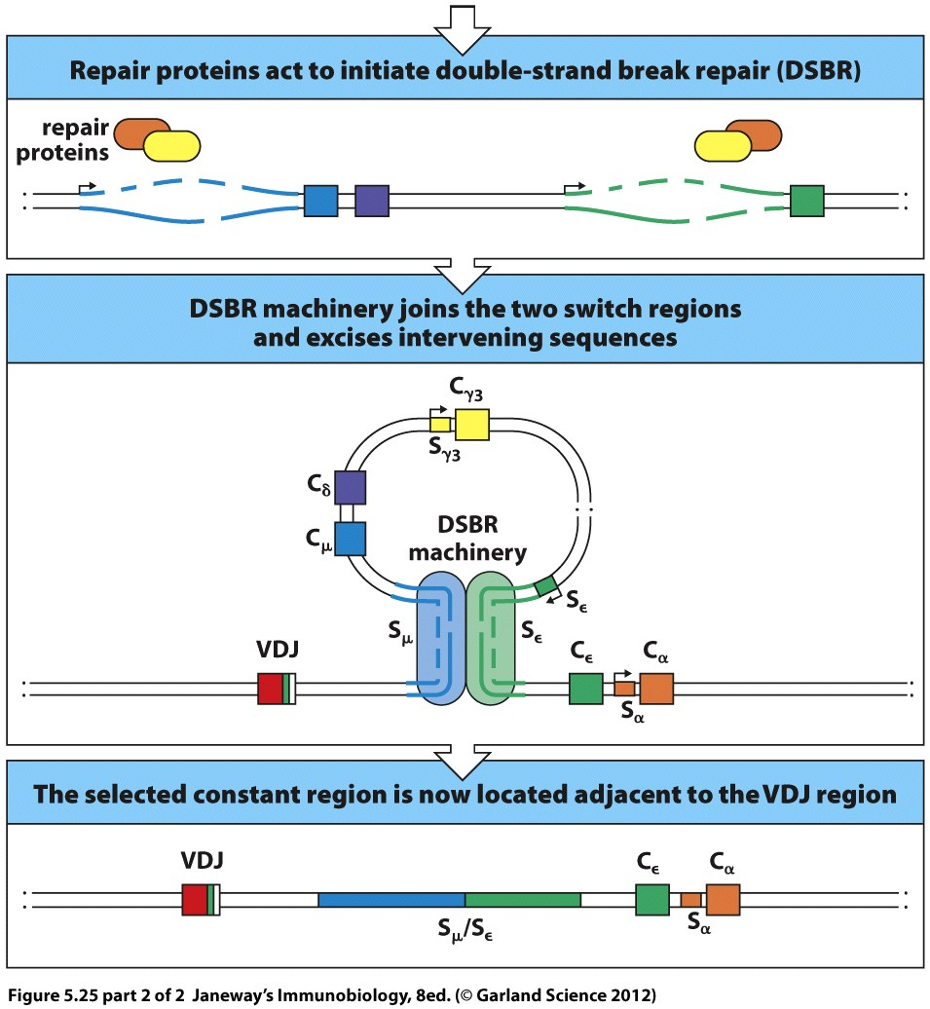

Slide 22
Multiple, successive switches can be made in the same B-cell.
Let’s return to the IgH locus and think about the process again:

Slide 24
IgM and IgD are expressed first. After that, the IgH C-region can switch in another C-region.
What if the switch is from IgM to IgA.
Draw what would happen
What other switches are possible after this switch?

Slide 25
Isotype/Class switch
Involves another type of somatic recombination within the IgH gene.
Uses a nucleotide sequence as a marker for the each C gene within the IgH. The signal is a stretch of repetitive DNA upstream of the C-gene. Called a switch signal. The switch signal is in non-coding DNA between C-genes.

Slide 26
Similar to somatic recombination in the V-region, the switch brings together 2 regions of the IgH locus (the V-region and one of the C –region genes).
All DNA in between is looped out and lost.
The move does not alter the V-region, and thus the specificity of the BCR does not change.

Slide 28
Multiple, successive switches can be made in the same B-cell.
Let’s return to the IgH locus and think about the process again:

Slide 30
IgM and IgD are expressed first. After that, the IgH C-region can switch in another C-region.
What if the switch is from IgM to IgA.
Draw what would happen
What other switches are possible after this switch?

Slide 31
We have outlined how this occurs at the level of the DNA making up the IgH gene. (Isotype switch signals and enzymes that cut and join a new C-region to the V-region.
What occurs in a persons blood? (one example follows)

Slide 32
Isotype switch/antibody class switch is also called seroconversion.
We can actually analyze serum from an individual during his/her humoral (antibody) response and note a switch in isotypes produced.

Slide 33
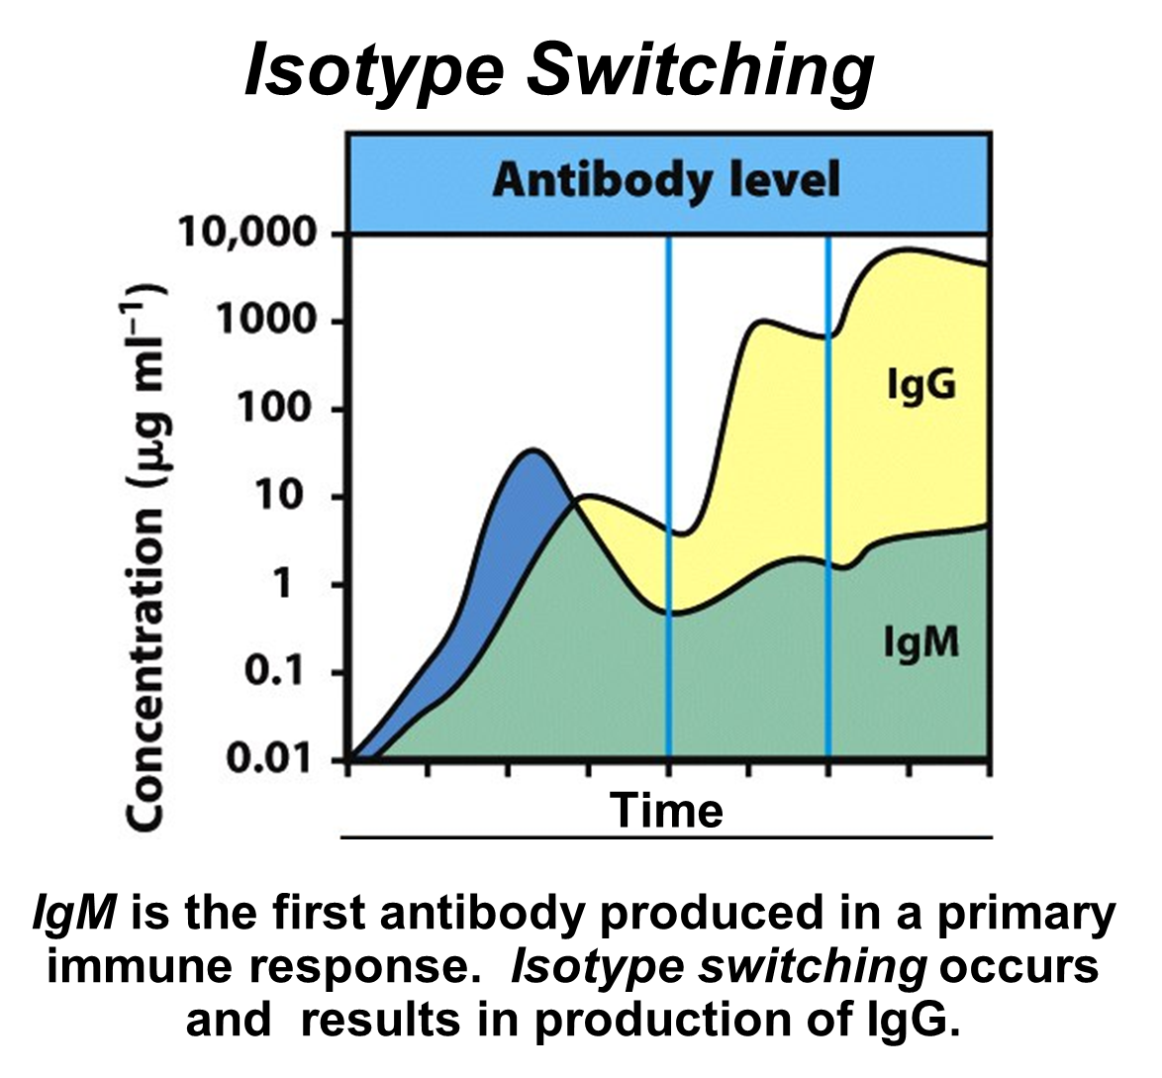

Slide 34
So…do all B-cells switch? Or just a subpopulation of them?...

Slide 35
So how do the isotype classes differ?

Slide 36
Recall what we have learned about antibodies thus far:
1. They assist in activation of complement
2. They neutralize directly
3. They are opsonins

Slide 37
Let’s just focus on the role of opsonization:
We’ve said opsonization marks the pathogen or molecule for phagocytosis.
How? Magic? NO!!
Requires a physical interaction with antibody and phagocyte.

Slide 38
Phagocytes have receptors for the Fc portion of the antibody:
This allows the antibody to contact antigen and the phagocyte to contact the antibody.
The phagocyte then ingests the pathogen after binding with Fc receptor.

Slide 39
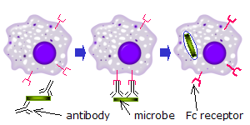
Many antibody isotypes bind to Fc receptors on phagocytes.

Slide 40
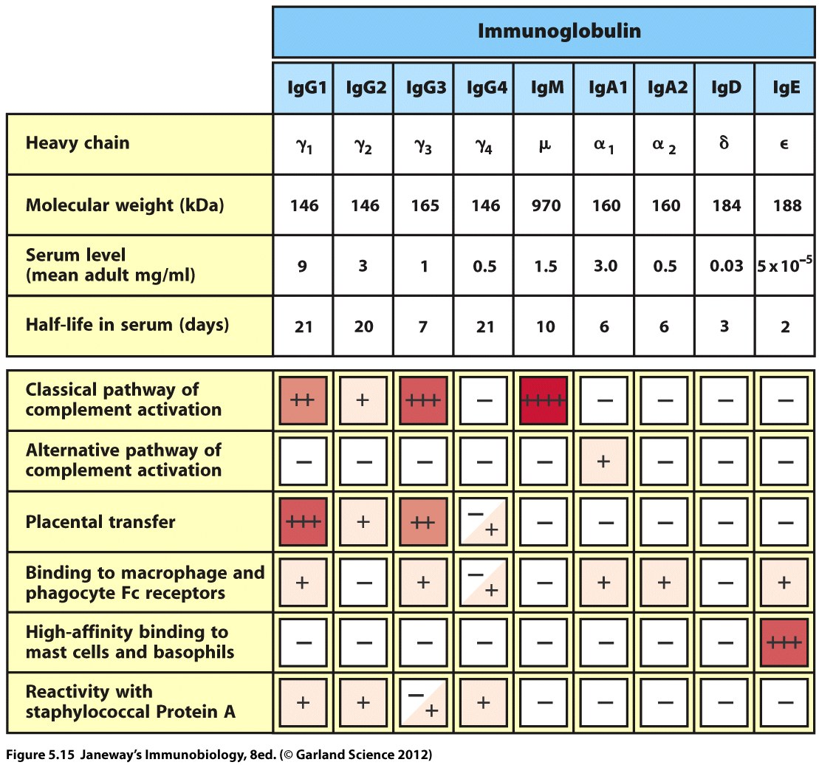

Slide 41
One difference in isotypes is where they can travel in the body
Note that one category of effector activity is placental transfer. IgG1 seems to excel at this!
Why would we care about placental transfer?
(Both beneficial and harmful examples!)

Slide 42
Infants have a very poor, underdeveloped immune system and require protection from infectious diseases by maternal antibodies.
Recall, cells should not cross the placenta, but nutrients and other small molecules do cross.
IgG antibodies cross and provide immunity for the infant during the first months of life.

Slide 43
How do antibodies cross?
…You guessed it---they bind to Fc receptors on the cells of the placenta.
The antibodies are not produced by the babies B-cells, but are functional. This is an example of passive immunity.

Slide 45
Let’s return to a feature of human blood type.
Rh antigen is medically important.
Some people express it on their RBCs, whereas some do not.

Slide 46
Unlike ABO blood type (The presence of A and/or B antigen on the RBC) where an individual produces antibodies against A and/or B antigen without known exposure, Rh antigen elicits a standard immune response…
One has to be exposed to the Rh antigen to make anti-Rh antibodies. Some women become exposed when giving birth.

Slide 47
Hemolytic disease of the newborn
How does it work?
Rh negative woman conceives an Rh+ baby
During pregnancy, no mixing of blood between mother and fetus, but at birth there is often a breach of the placenta and fetal cells can enter the maternal blood stream.
Fetus RBCs with Rh antigen are seen as non-self, possibly pathogen and mother’s immune system responds—Mother makes anti-Rh antibodies.

Slide 48
In subsequent pregnancies, Rh+ RBCs of babies will be seen as pathogens and anti-Rh antibodies CAN transfer across the placenta.
Developing circulation of the baby is destroyed. RBCs are lysed by antibodies.

Slide 49
Solution?
In first and all pregnancies, Rh- mother can be given a glob on antibodies which will destroy any Rh+ cells of the baby BEFORE the Rh- mother’s B-cells can be primed to produce them. (These do not transfer to placenta)
The glob of antibodies will not last long---they will become inactive and should not affect the developing fetus’s RBCs.

Slide 51
IgA antibodies are also a component of maternally provided immune protection.
IgA antibodies can cross into milk ducts and are concentrated in breast milk. They are not destroyed in the gut of the infant, but are absorbed into the bloodstream from the intestinal tract. Thanks MOM!

Slide 52
Colostrum is the name for the first milk produced after delivery of offspring in mammals.
It is loaded with antibodies and virtually every protein we’ve discussed related to innate immunity!

Slide 53
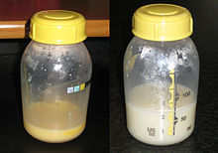
colostrum

