Slide 1
Immunology Biol 465 Minot State University Spring 2020
MWF 9-9:50 am
Lab Tuesdays 9am-noon

Slide 2
Lecture 21 March 13th , 2020
Lab journal---Turn in Friday, March 13th.
See you April 5th ? Please check email regularly. Lectures will continue to be uploaded for MWF. Quizzes and Labs—TBD. No quiz 4 on March 23rd.
It’s your responsibility to check email and website for expectations for learning. We will get through this as best we can.

Slide 3
Where were we?
How is the TCR ligand put together?
Antigen processing and presentation by MHC class I
Immunoevasins—Pretty cool---viruses are smart.
Antigen processing and presentation by MHC class II.

Slide 4
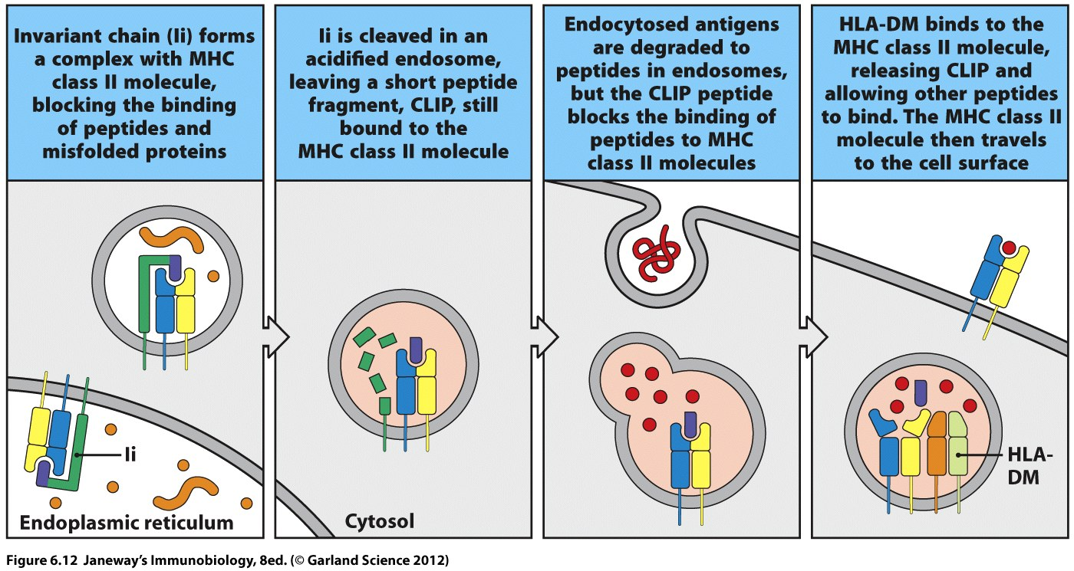

Slide 5
Recall that all of this antigen processing and presentation is going on in a cell infected with a pathogen, or a cell whose role is to ingest some of the pathogen and present it to the T-cell.
Virtually all cells make MHC I
Only antigen presenting cells (dendritic cells, macrophages), B-cells, and some cells of the thymus make MHC II

Slide 6
Moving on…
The remainder of chapter 6 considers MHC, but not the protein---the gene(s).
The “C” in MHC refers to the complex of genes that encode the MHC proteins.

Slide 7
Some basics..
Recall:
in humans the MHC genes encoded at the HLA locus
*Chromosome 6: 4-7 million bases in length
in mouse the MHC genes are encoded at the H-2 locus
* Chromosome 17: 4-7 million bases in length

Slide 8
The complex includes:
Genes encoding MHC I proteins, MHC II proteins and MHC III proteins (some of the complement proteins)
TAP 1/TAP 2
LMP (proteasome protein)
Tapasin
HLA-DM

Slide 9
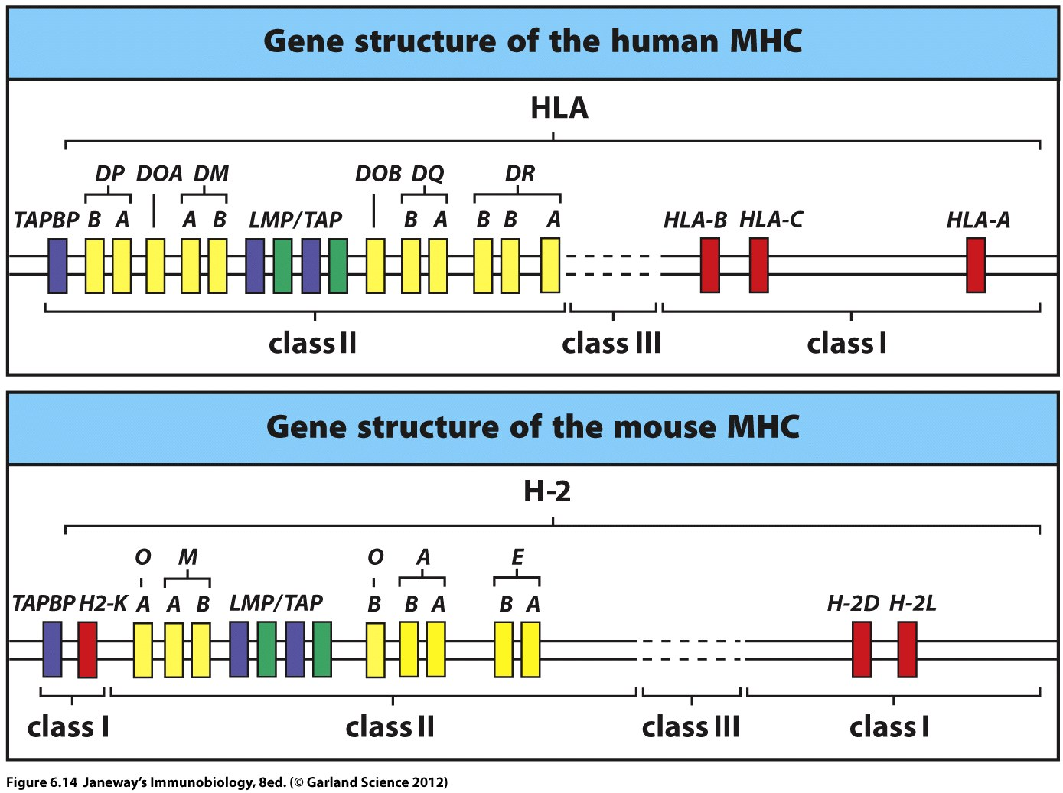

Slide 10
Speculate on the organization of the complex
Compare human and mouse. What do you notice? Is this an important set of genes? Did evolution tinker /change much?
We call this similarity in genes across species—conservation/conserved genes. It implies a similar, important function. (Can you think of genes that might be conserved in nearly all living things?)

Slide 11
Why a complex?
Placing genes in close proximity allows for more coordinated expression (transcription and translation) of several genes. (Why would we want these genes expressed at the same time?)
Several genes may share a common regulatory mechanism. (recall a role for IFNγ)
*resembles the bacterial operon system.

Slide 12
MHC—an unusual locus
MHC is such an important set of proteins for survival; it’s role in protection from pathogens requires it to vary (in an individual and in the population) more than any other locus.
Why? To present the maximum number and types of antigens to T-cells. (T-cells then do the job of destroying the pathogen directly or indirectly)

Slide 13
2 mechanisms to allow MANY versions of MHC to be expressed
MHC is polygenic—each individual has several MHC I and MHC II genes (each is a little different in sequence)
MHC is polymorphic—in the population, there are MANY alleles for MHC.
MHC I (humans)---~500-1400 different alleles
MHC II (humans)--~3-800 different alleles

Slide 14
To clarify---a gene with only one allele (NO variation in the population) is monomorphic. A gene with 2 alleles is dimorphic….

Slide 15
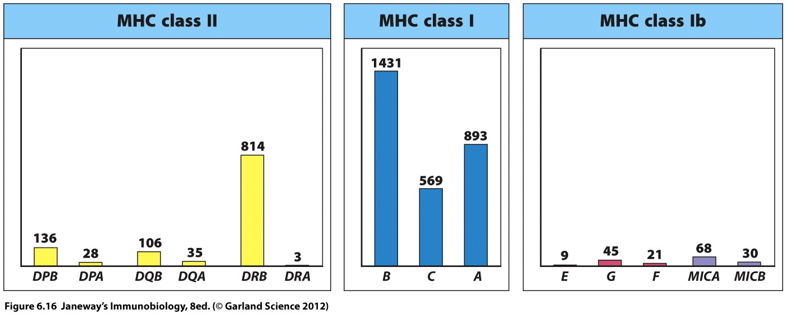
These graphs show the number of different alleles identified in humans for each of the MHC genes.

Slide 16
Compare this to something you’re familiar with….how many alleles for ABO blood type antigen? (Three--Not hundreds!!!)
I⁰
I^{A}
I^{B}

Slide 17
Limited variation is allowed by individual genes
3 I gene alleles and the specific dominance scheme gives 4 blood types. Variation is limited to 4 specific phenotypes.
(Mendel only observed 2 types of each trait in garden pea plants, and this was explained by 2 alleles for each gene)

Slide 18
Ultimately the MHC expressed at the cell surface of different individuals reflects polygeny combined with polymorphism.

Slide 19
This figure shows a person with 2 different alleles for a given MHC gene. Both can be expressed at the cell surface. (MHC genes exhibit co-dominance)
How many types of MHC?

Slide 20
This figure shows 3 different genes for the same protein (say, MHC I). Since they are shown in 3 colors, we assume that they differ some in DNA sequence and thus would give different folded structures in the expressed proteins.
How many types of MHC?

Slide 21
This figure shows the combined effect of polygeny and polymorphism.
How many types of MHC?

Slide 22
Let’s think of what this really means---using a familiar type of figure.
What do we mean by different alleles in the population?
How does that really change the MHC expressed?

Slide 23
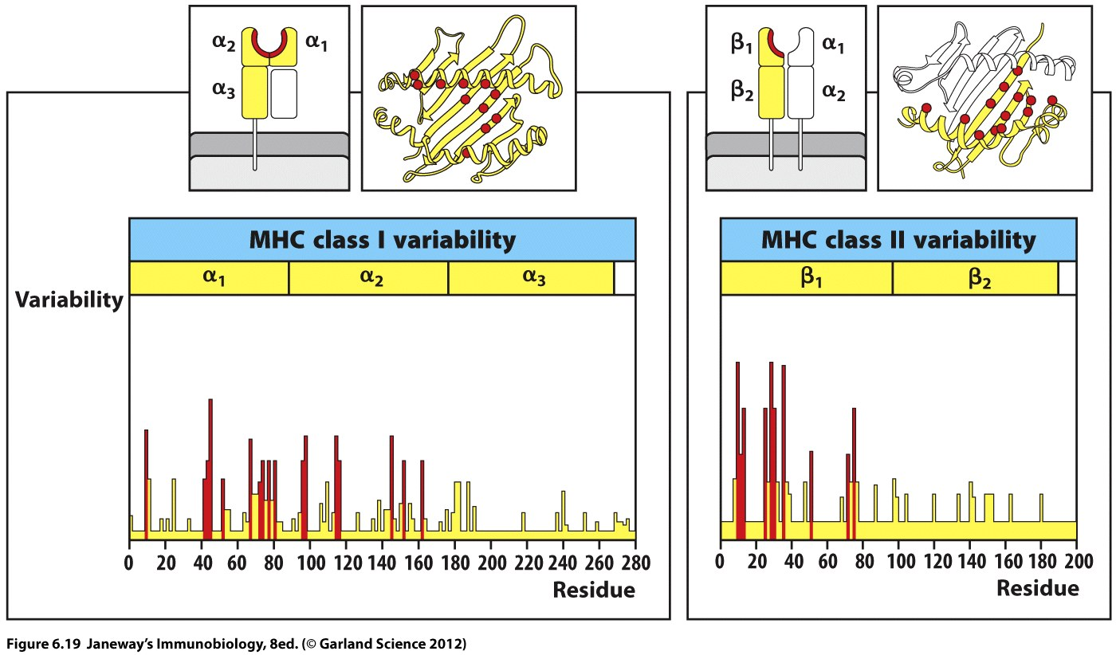

Slide 24
Of course the variability in the AA/residue ultimately comes from variability in the DNA sequence (different alleles!)

Slide 25
Recall the analysis of peptide binding in MHC cleft.
Analysis of different antigens, including peptides from pathogens shows how variability in the MHC helps different peptides bind more stably.
Compare just 2 alleles of MHC I in mouse. They bind different sets of peptides with different anchor residues.

Slide 26
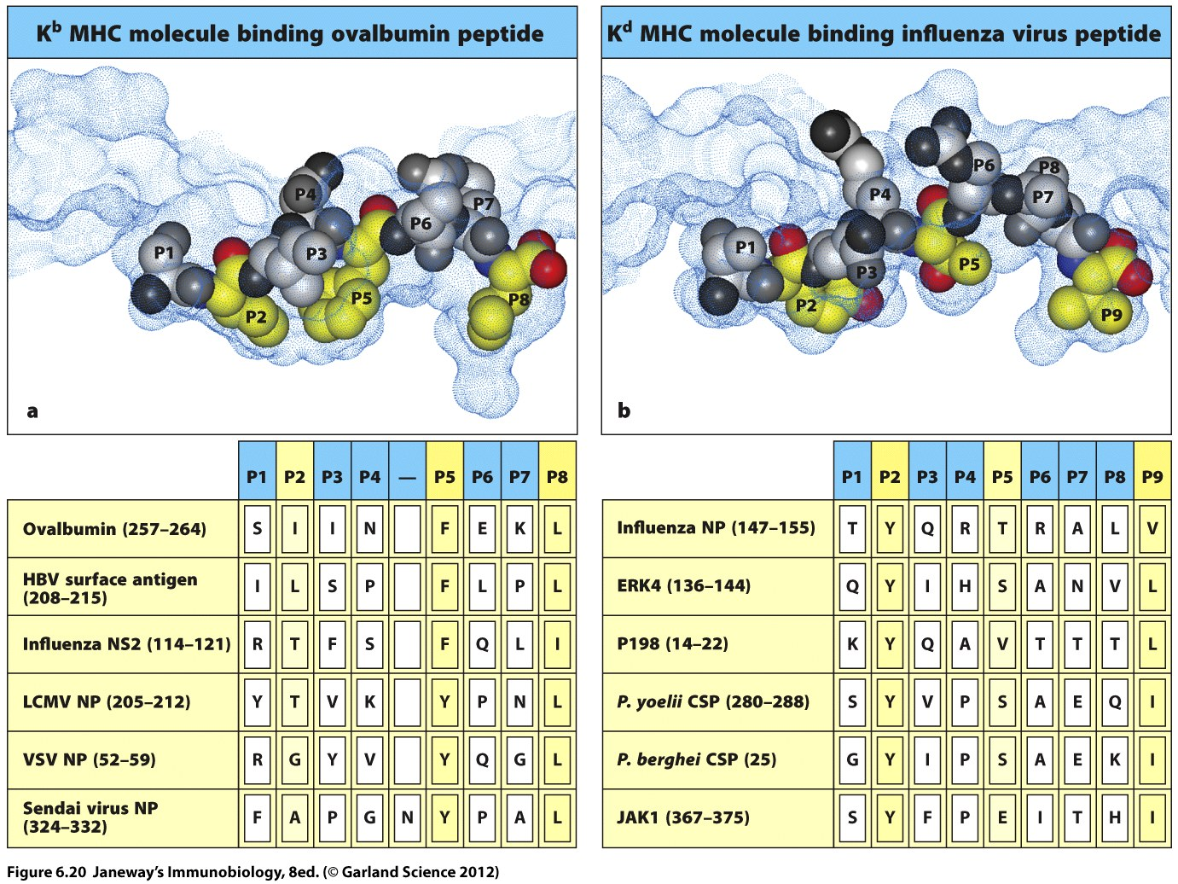

Slide 27
Because of the degree of polymorphism in the MHC genes, we expect nearly every individual to be heterozygous for all the MHC loci.
(Your parents likely had different genotypes, and your grandparents as well….and so on.)

Slide 28
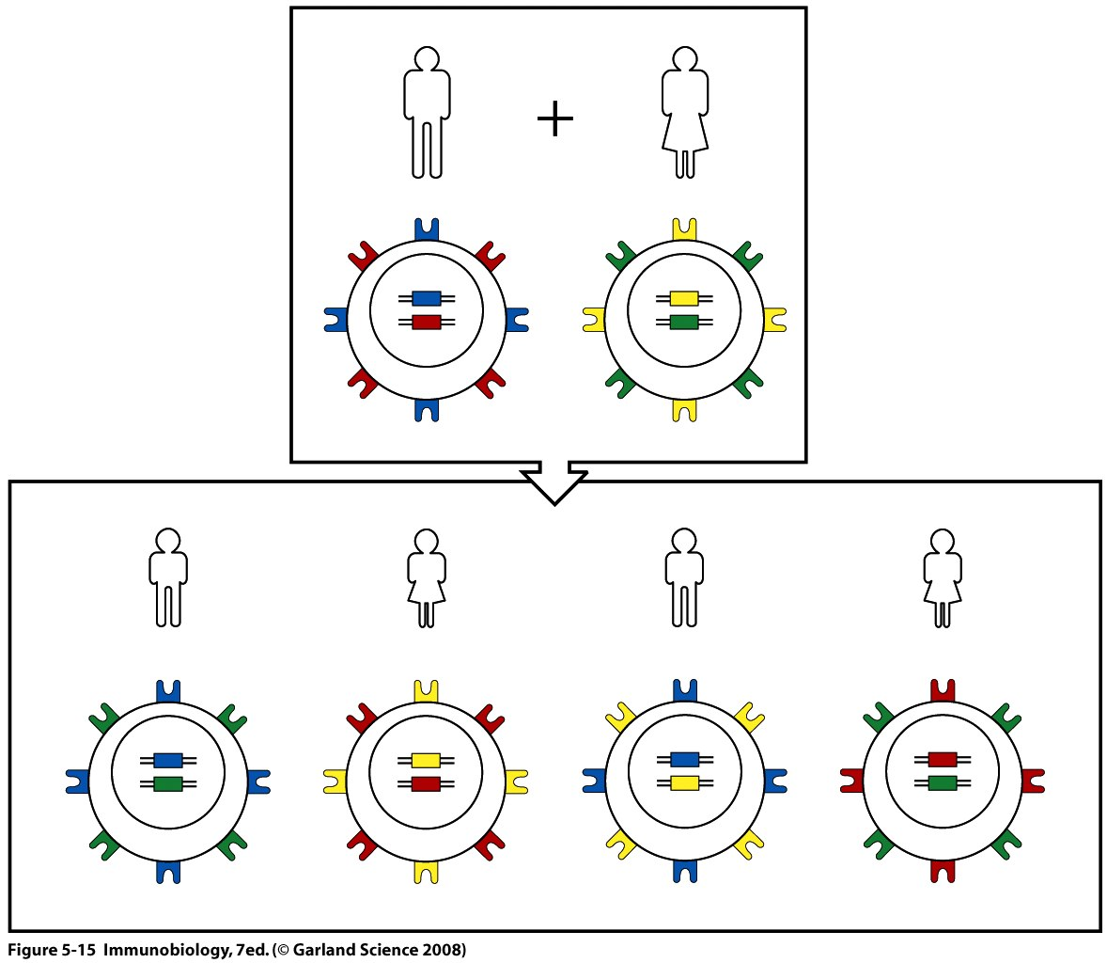

Slide 29
Heterozygosity at MHC is a definite advantage. One piece of support is seen in laboratory mice. Researchers like to use inbred mice to obtain genetically identical animals.
Inbreeding results in homozygosity at all loci.
Lab mice are often much more susceptible to infectious disease… They are housed in very high tech lab environments to minimize exposure to pathogens.

Slide 30
Let’s step back and think about polygeny and polymorphism.
The genes you carry around right now have been selected over a couple million years because they helped you survive.
Having lots of variation in our MHC helps us survive!

Slide 31
How?
Having variation in our MHC allows us to present many different antigens, from many different pathogens to our T-cells.
We are better equipped to survive pathogen infection with variation in MHC.

Slide 32
Individually you are still somewhat limited in the variation---after all you can only express 2 alleles for each gene.
Still, being heterozygous maximizes the variability of any gene showing co-dominant expression.

Slide 33
But as a species---the high degree of polymorphism allows some individuals to better resist some pathogens while other individuals to resist others…
No single pathogen would be expected to wipe out a large group.

Slide 34
But we do see evidence of pathogen driven selection for certain MHC alleles….

Slide 35
In regions where a specific pathogen predominates we see selection for a specific MHC allele.
Example---In West Africa, the malaria parasite is a persistent pathogen. Survival is higher in people who express a specific MHC allele (HLA B53)
Why might this be the case? This is a good test of your understanding!
There is a higher frequency of this allele in Africa than in North Dakota! Why?

Slide 36
Recall it’s the interaction of T-cells and MHC that ultimately results in the effector mechanism (that helps the host survive the pathogen).
A surprising discovery was made by 2 immunologists in the 1980s. Peter Doherty and Rolf Zinkernagel described a phenomenon called MHC restriction.

Slide 37
MHC restriction refers to the idea that T-cells recognize specific peptide antigen AND a specific allele of MHC.
A given T-cell must be presented with peptide by MHC that has been present during its development.
Presentation of the same peptide in a different form of MHC does not elicit the same response.

Slide 38
