Slide 1
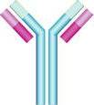
Immunology Biol 465 Minot State University Spring 2020
MWF 9-9:50 am
Lab Tuesdays 9am-noon

Slide 2
Lecture 26 For April 6th , 2020
Announcement-
Still…making my way through quizzes. It’s slow but I’m giving feedback individually—more commenting than before since we won’t go over it in class.
Lab quiz 2 set for April 7th, (Tuesday—9:00-10:30 am). See guidelines on regular website.
Please let me know ASAP if you lack resources---do you have your lab materials (besides your journals) where you are now.

Slide 3
Where were we?
Lymphocyte development—Chapter 8
What is allelelic exclusion?
What can happen to a self-reactive B-cell?

Slide 4
B-cells try so very hard…;)
They can even attempt, during the selection process to become useful! This last attempt is called receptor editing.
How is receptor editing just one more way in which a B-cell “Try so very hard“ to remain part of the B-cell repertiore during development.

Slide 5
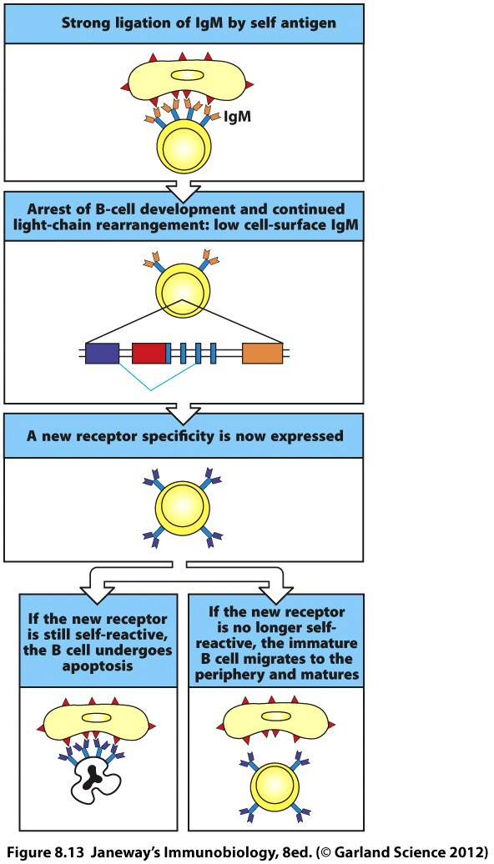
Receptor editing

Slide 6
T-cell (thymocyte) development
Recall the “T” stands for Thymus-dependent cell.
T-cells migrate from the bone marrow to the thymus fairly early in development. The thymus is the site of TCR gene rearrangement (review this)

Slide 7
Similarities to B-cell development
Requires productive TCR gene rearrangement
T-cells are stringently tested for self-recognition.
***Selection is more complicated---Why?
T-cells must interact with self MHC and a foreign antigen peptide

Slide 8
The basic role of the thymus has been studied in athymic conditions in which there is no thymus or no functioning thymus—
DiGeorge syndrome---humans
Nude mice
Surgical removal

Slide 9
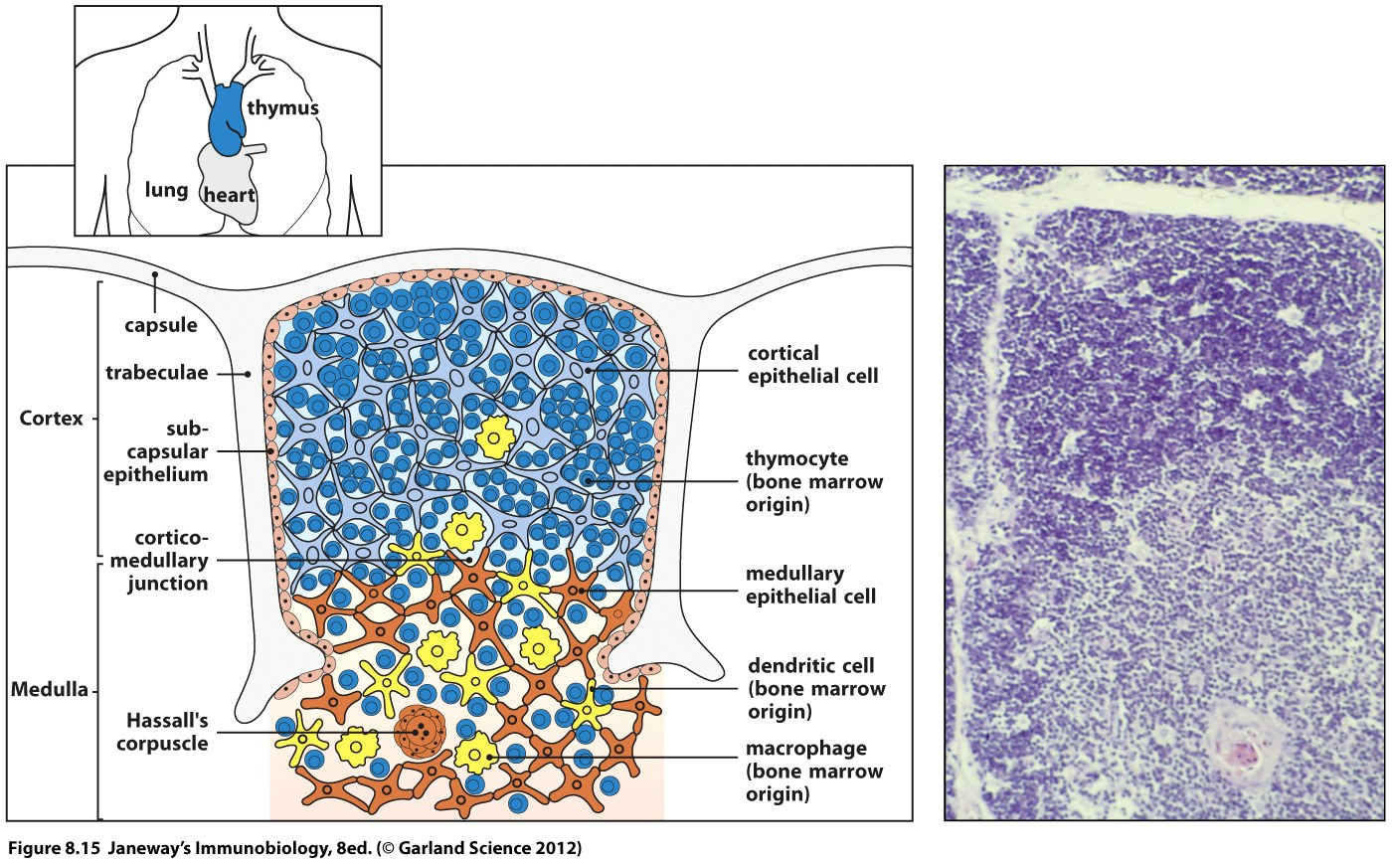

Slide 10
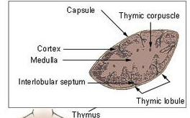
Thymus architecture

Slide 11
Review the blue histology handout.
Be sure you could recognize the tissue---Hassal’s corpuscle is an interesting huge cell/cell complex that is seen in Thymus.
https://en.wikipedia.org/wiki/Hassall%27s_corpuscles

Slide 12
As a tissue, the thymus is made up of epithelial cells called:
Corical epithelium
Medullary epithelium
But within the thymus are lots of developing T-cells, dendritic cells, and macrophages---all migrate in from the bone marrow.
Thymic stroma

Slide 13
In addition to athymic conditions…
The disease known as Severe Combined Immunodeficiency (SCID) results from defects in antigen receptor gene rearrangement. (can result from defects in a number of different genes.)
SCID individuals lack T-cells, despite having a functional thymus
They also lack B-cells

Slide 14
The following experiment showed that the same phenotype (no T-cells) can result from different defects.
It shows that each mouse has a unique abnormality resulting in no T-cells. Each mouse can, in fact, correct the others’ abnormality.

Slide 15
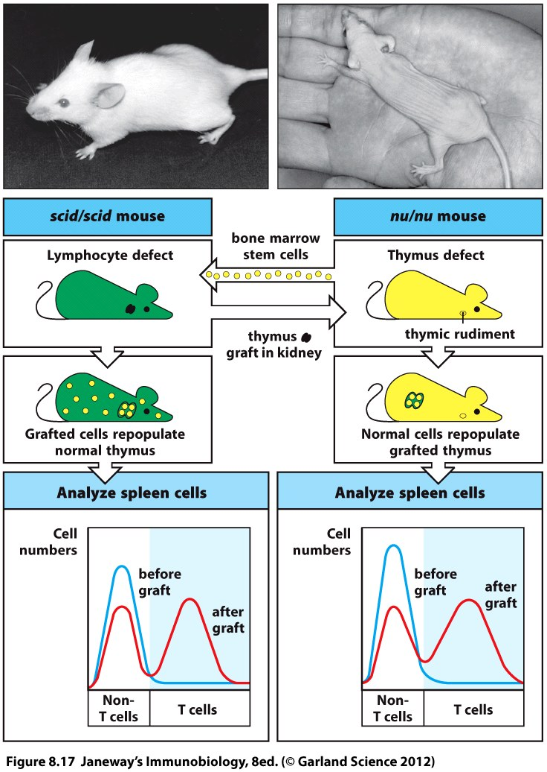

Slide 16
Once a T-cell makes it to the thymus it spends up to one week differentiating (acquiring T-cell characteristics—like making TCR--you should be familiar with this process)
After this, the T-cells begin to proliferate like crazy! In a young adult mouse, the thymus makes about 50 million T-cells/day!

Slide 17
Why so many?
The odds of survival for any T-cell are pretty slim. Only 2 % of developing T-cells become part of the T-cell repertoire.
98% die by apoptosis.

Slide 18
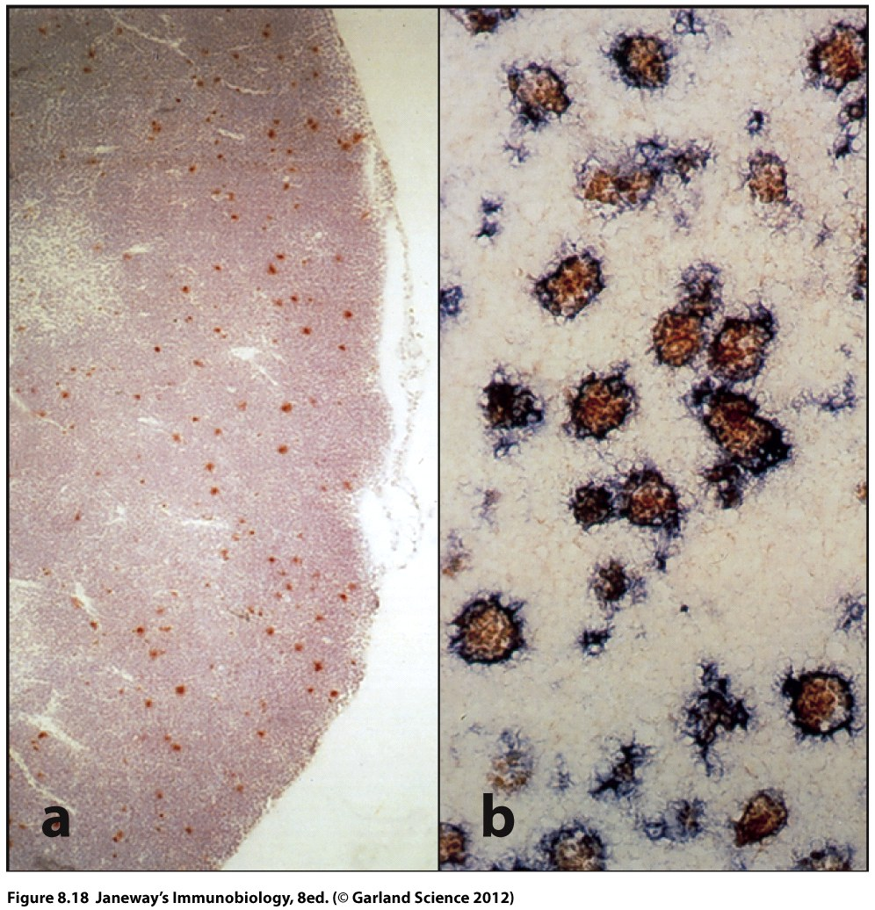
Apoptotic cells in the thymic cortex
(red cells are undergoing apoptosis)
Apoptotic cells being engulfed by macrophages
(purple stained cells are macs)

Slide 19
The thymus is one of the most intense regions of apoptosis in the bodies of mammals.
But back to why?...Why so much apoptosis. It reflects the intense screening endured by developing thymocytes to establish a good supply of self-tolerant T-cells.

Slide 20
Stages of T-cell development
In addition to rearranging the TCR the T-cell must express different surface accessory molecules and co-receptors.
Recall---the TCR signals through a complex called CD3
Mature T-cells also express either CD4 or CD8

Slide 21
The developing T-cell goes through an interesting progression of expression of these molecules.
We can test for the presence of each type of molecule on developing T-cells using fluorescently (or other ) tagged antibodies.

Slide 22
You can see the cells that fluoresce in one of 2 ways.
1. Directly---Fluorescence microscopy or microscopy that detects the antibody in some other way.
This approach involves making a slide of tissue and then staining the slide with the labelled antibodies.
The approach is known as immunohistochemistry.

Slide 23
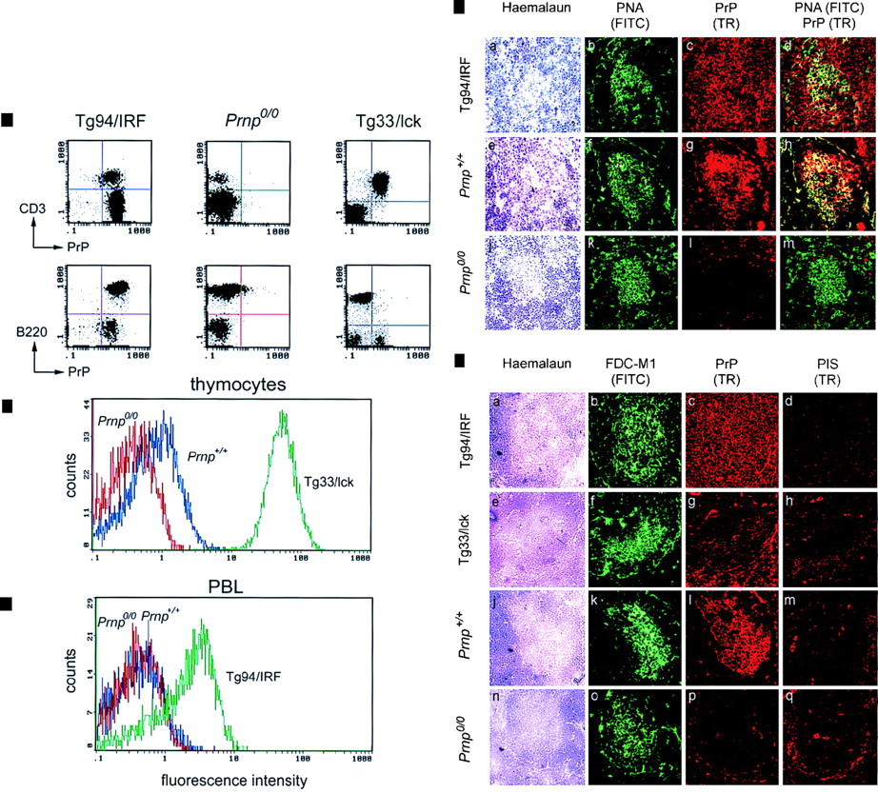
This figure shows the location, in a tissue of cells expressing 2 different antigens.
General staining of tissue
Use of specific antibody #2
Use of specific antibody #1
Use of specific antibody #1 and #2

Slide 24
Indirectly---using that technology called FACS (fluorescence activated cell sorter) analysis, fluorescently labeled cells are detected by a laser and sorted into populations

Slide 25
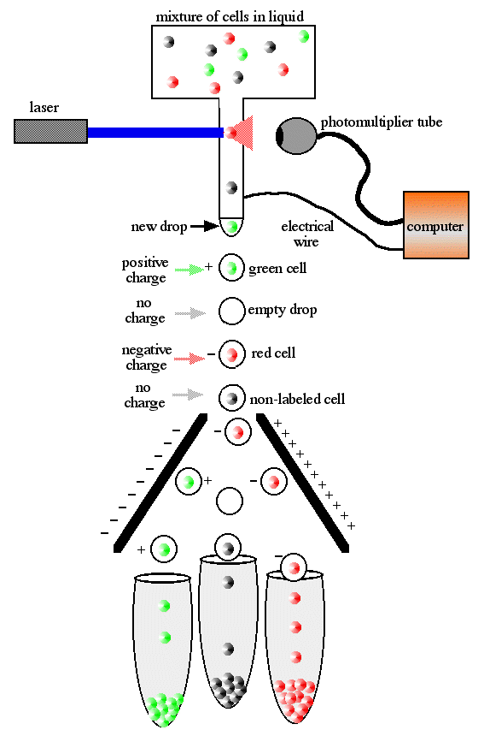

Slide 26
The first ”on-line” lab I will present, will discuss FACS analysis---It will relate back to lab 3---

