Slide 1
Immunology Biol 465 Minot State University Spring 2020
MWF 9-9:50 am
Lab Tuesdays 9am-noon

Slide 2
Lecture 27 For April 8th , 2020
Announcement-
I finished grading quiz 4. Please let me know if you can’t see a grade and/or comments. I will send an attachment to an email later this week with a partial key for that quiz--
I have not started grading Lab quizzes yet---
I plan no lectures Friday April 10 or Monday April 13th as we had them as Easter break days before the switch to online.

Slide 3
Coming up.
First online lab---Tuesday April 14th. Format TBA.
Quiz 5—now scheduled for Monday April 20th.
Planning no term paper or presentation. Points for the class adjusted accordingly

Slide 4
Where were we?
We really focused on T-cell development last time.
After making functional TCR---The T-cell starts to express co-receptors, CD3, CD4, CD8.
All mature T-cells express CD3
Mature T-cells express either CD4 or CD8

Slide 5
The developing T-cell goes through an interesting progression of expression of these molecules.
We can test for the presence of each type of molecule on developing T-cells using antibodies.
Can see directly T-cell expressing each type of co- receptor—using immunohistochemistry
You can use more than one antibody to detect multiple antigens (such as the co-receptors) simultaneously

Slide 6
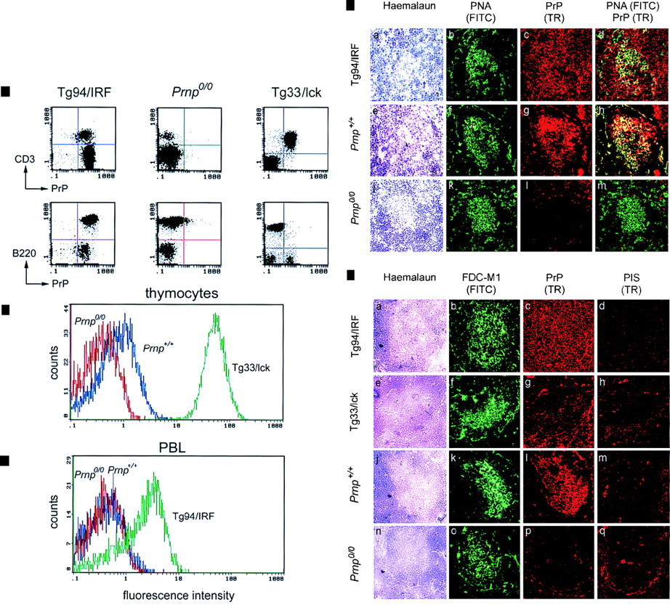
Pretend an antibody to CD3 was labeled in green. An antibody to CD4 was labeled in red.
The figure shows how you might examine a slice of thymus tissue and see:
H and E staining showing the location of cells
Green stained cells indicating the CD3+ ones
Red stained cells showing the CD4+ones
What do the CD3+/CD4+ cells look like when both antibodies are used?
This figure shows the location, in a tissue of cells expressing 2 different antigens.
General staining of tissue
Use of specific antibody #2
Use of specific antibody #1
Use of specific antibody #1 and #2

Slide 7
Immunocytochemistry technique
Staining individual cells with fluorescently-labelled antibodies:
Followed by: FACS (fluorescence activated cell sorter) analysis.

Slide 8
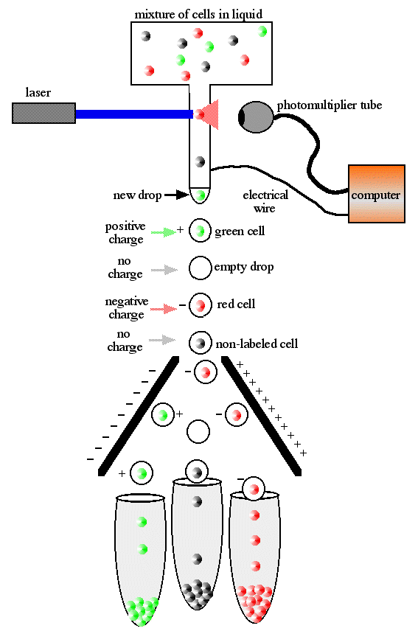

Slide 9
Next week’s lab will introduce you to FACS analysis.
Several graphs in the next slides show typical ways of analyzing expression of antigens in cells.

Slide 10
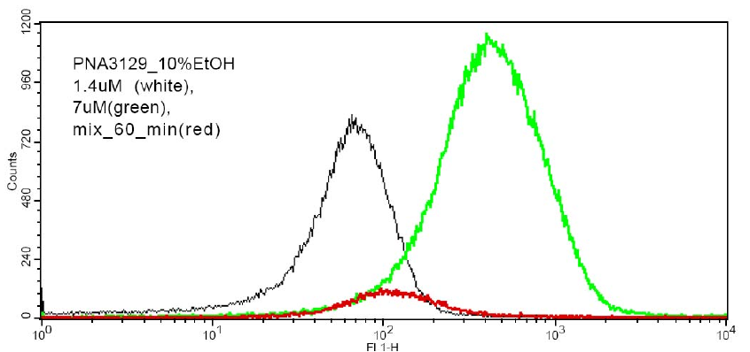
The intensity of the fluorescence is measured on the X axis. A cell with lots of copies of the cell surface antigen will flouresce brighter than one with fewer copies.

Slide 11
2 or 3 distinct populations of cells are visible from this analysis. I’ve color coded to help.
The Y-axis shows the number of cells
showing a given level of fluorescence intensity.

Slide 12
Often, 2 antigens (sometimes called markers) are detected at the same time. We can determine distinct populations that express one marker, the other marker, or both markers.
A grid is used to display the populations.

Slide 13
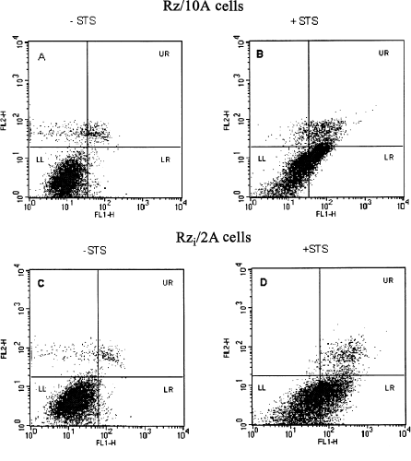
Marker 2
Marker 1
Marker 1

Slide 14
Marker 2
Marker 1
Marker 1
Low expression of both markers (most cells here)

Slide 15
Marker 2
Marker 1
Marker 1
High expression of both markers

Slide 16
Marker 2
Marker 1
Marker 1
Low expression of marker 1
High expression of marker 2

Slide 17
Marker 2
Marker 1
Marker 1
Low expression of marker 2
High expression of marker1

Slide 18
Using FACS analysis, we can measure the cell surface markers on developing T-cells.
They go through an interesting sequence before finally expressing either CD4 or CD8.

Slide 19
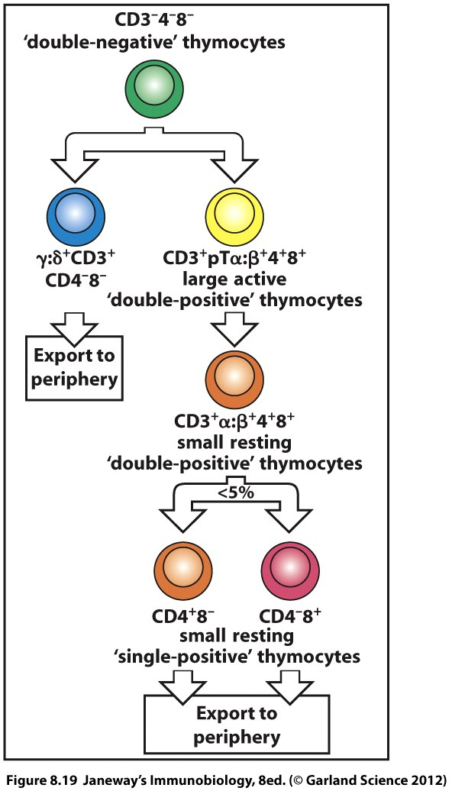

Slide 20
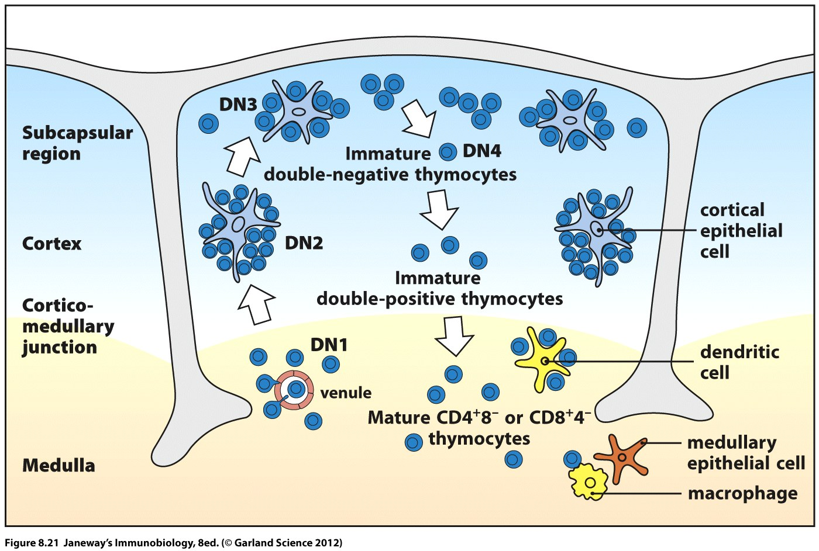

Slide 21
T-cell selection
T-cell selection is a bit more complicated than what we’ve seen in B-cells.
T-cells are first tested for an ability to bind to self MHC and self peptide. Thymic stromal cells present antigen to developing T-cells. T-cells that can bind receive survival signals.
This is known as positive selection.

Slide 22
An interesting experiment in mice shows that the T-cells that become part of an animal’s final repertoire respond to antigen presented by the MHC type that was present when they developed but not to other types of MHC.
Recall this phenomenon of MHC restriction

Slide 23
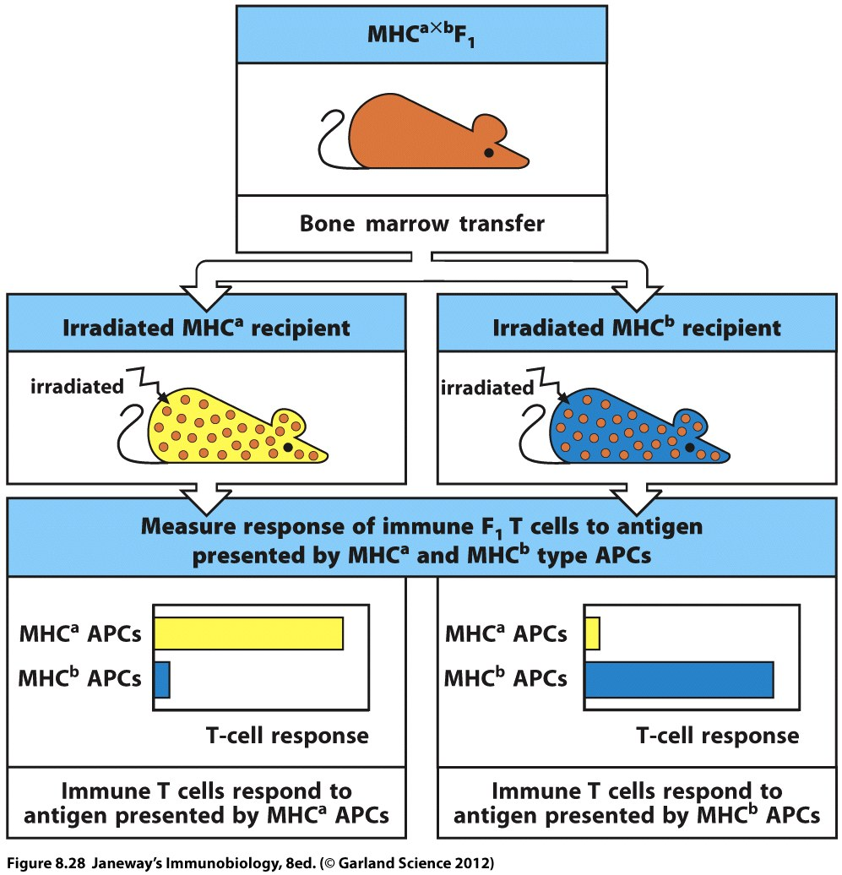
Irradiation destroys recipients’ potential T-cells

Slide 24
This mouse donates stem cells (potential T-cells)
Irradiation destroys recipients’ potential T-cells
Irradiation destroys recipients’ potential T-cells
Recipients have only one of the types of MHC compared to the donor cells

Slide 25
During this phase of positive selection, the T-cells are double positive (CD4+ and CD8+) but upon binding of MHC I a developing T-cell will shut down CD4 expression and become single positive CD8+ T-cell
Likewise—a T-cell that binds well to MHC II will become single + CD4+ T-cell.

Slide 26
Again this is supported experimentally in a mouse system where the mouse was made to make T-cells that express a specific type of TCR that was known to bind to MHC I.
In these mice, only CD8+ T-cells develop.

Slide 27
Likewise, when a mouse is made experimentally to make T-cells that bind to MHC II ---only CD4+ T-cells are made.

Slide 28
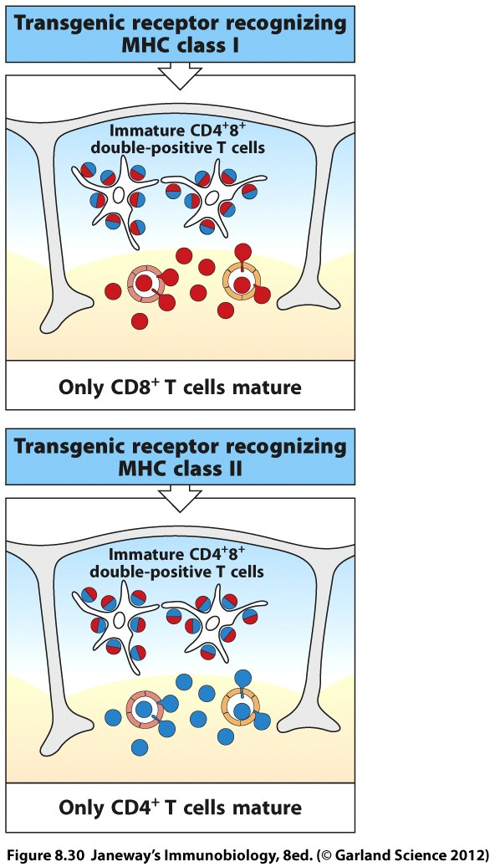

Slide 29
More evidence for the role of host MHC on development of T-cells comes from diseases known as bare lymphocyte syndromes.
In bare lymphocyte syndromes, individuals lack MHC I or MHC II. Although this would be expected to affect T-cell activation, we now know that it affects T-cell development.

Slide 30
People who can’t make MHC I don’t make CD8+ T-cells
People who can’t make MHC II don’t make CD4+ T-cells.

Slide 31
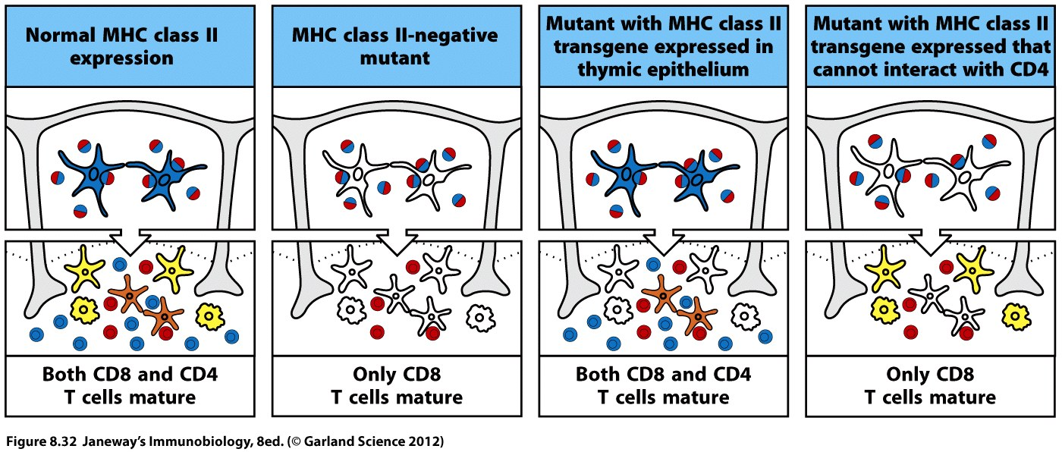

Slide 32
What about negative selection?
T-cells might be great at binding to MHC, but may also bind to self antigen.
Actually binding to self peptide a little is a criteria for survival (it is a general test for the TCR)

Slide 33
But…
A TCR which binds with high affinity to self peptides in the thymus is programmed to die by apoptosis.
This is negative selection.

Slide 34
The following slide shows an experiment in which mice were engineered to make a TCR which binds a specific self peptide.
After a time, loads of the peptide were injected into the thymus and many thymic stromal cells presented this particular peptide over others.

Slide 35
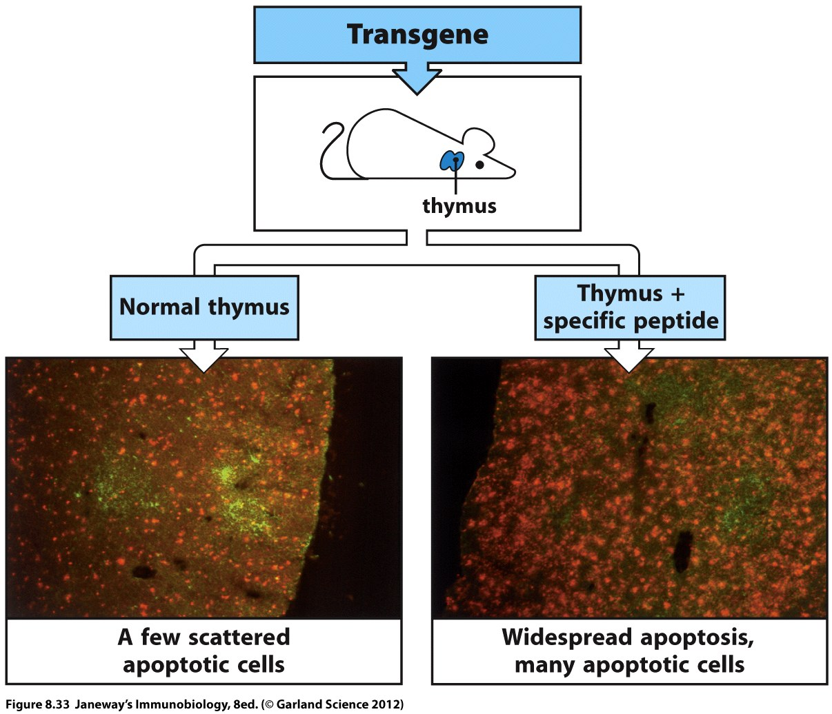

Slide 36
Negative selection must be pretty efficient. It is hard to imagine how one tiny organ (the thymus), which is is highly specialized to “train” T-cells to recognize MHC, could also express all of the possible self antigens a T-cell might run into.
Recall the hallmark of specialized cells is that they express a unique subset of proteins that other cells do not.

Slide 37
For example---when might a developing T-cell get the chance to “see” a peptide from insulin?
Cells of our T-cell repertoire must not bind insulin peptides and react against cells expressing insulin (pancreatic cells)
If they do? Diabetes may develop.

Slide 38
It would be silly, and wasteful for the thymus to produce insulin. That is the job of the pancreas.
However, a gene expressed in the thymus does make sure that developing T-cells do get to see a wide range of peptides from ubiquitous proteins (like insulin).

Slide 39
The gene is known as AIRE (autoimmune regulator). It is expressed in medullary thymic stromal cells and activates some expression of genes that aren’t really supposed to be active in thymus.
This makes sure T-cells have a chance to be tested for self reactivity to proteins they will encounter in the periphery (after they leave the thymus).

Slide 40
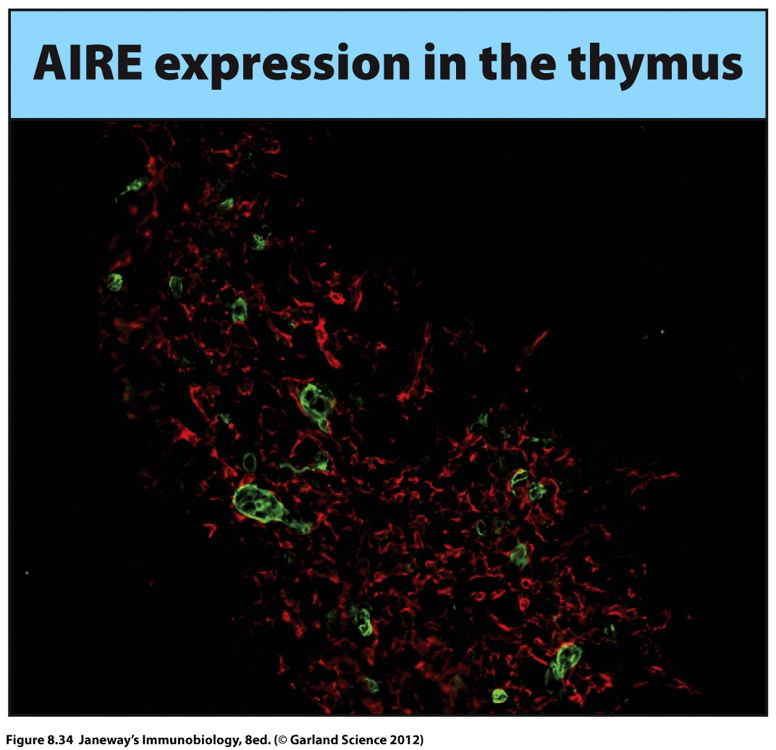
Red cells are thymic epithelium
Green cells are a subset which express AIRE

Slide 41
Hey…what technique was used in the last slide?
Predict the what occurs in people with mutations in AIRE. (Defects in the function of AIRE)

